Slide 1
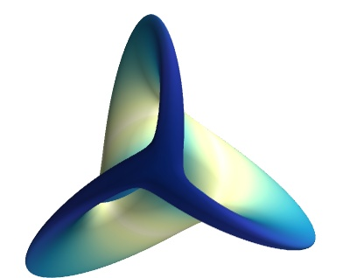
Introduction to Mayavi: 3D scientific visualisation
Louise Head
1st April 2024

Slide 2
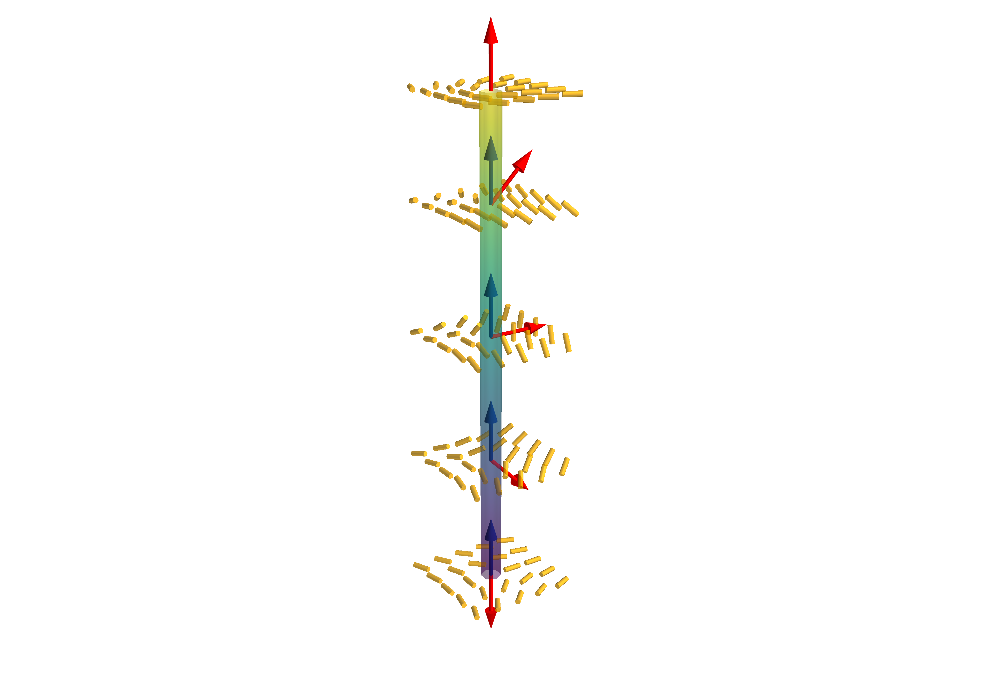
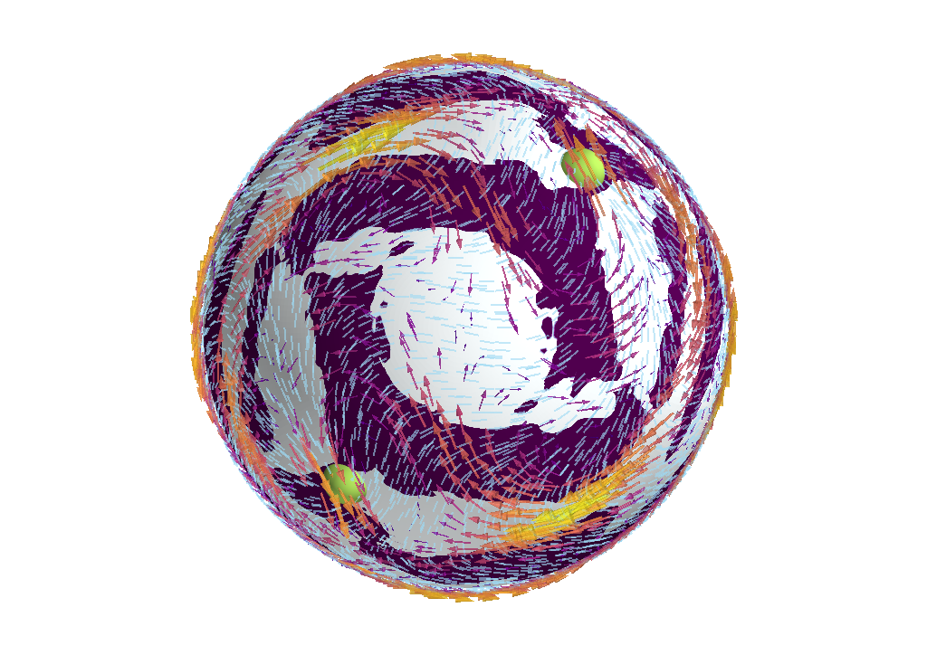
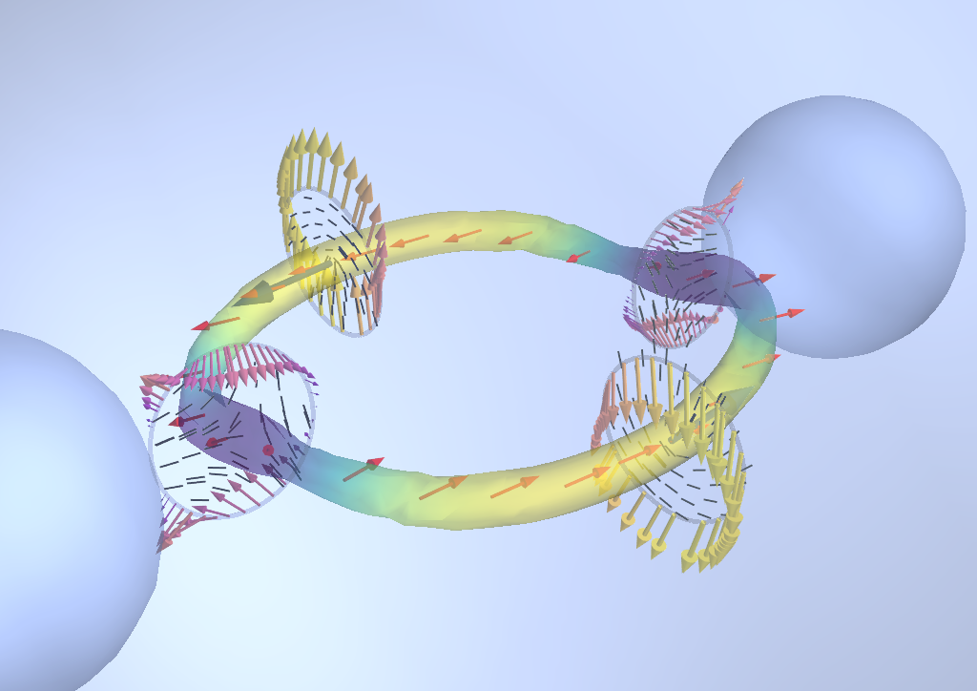
Examples

Slide 3
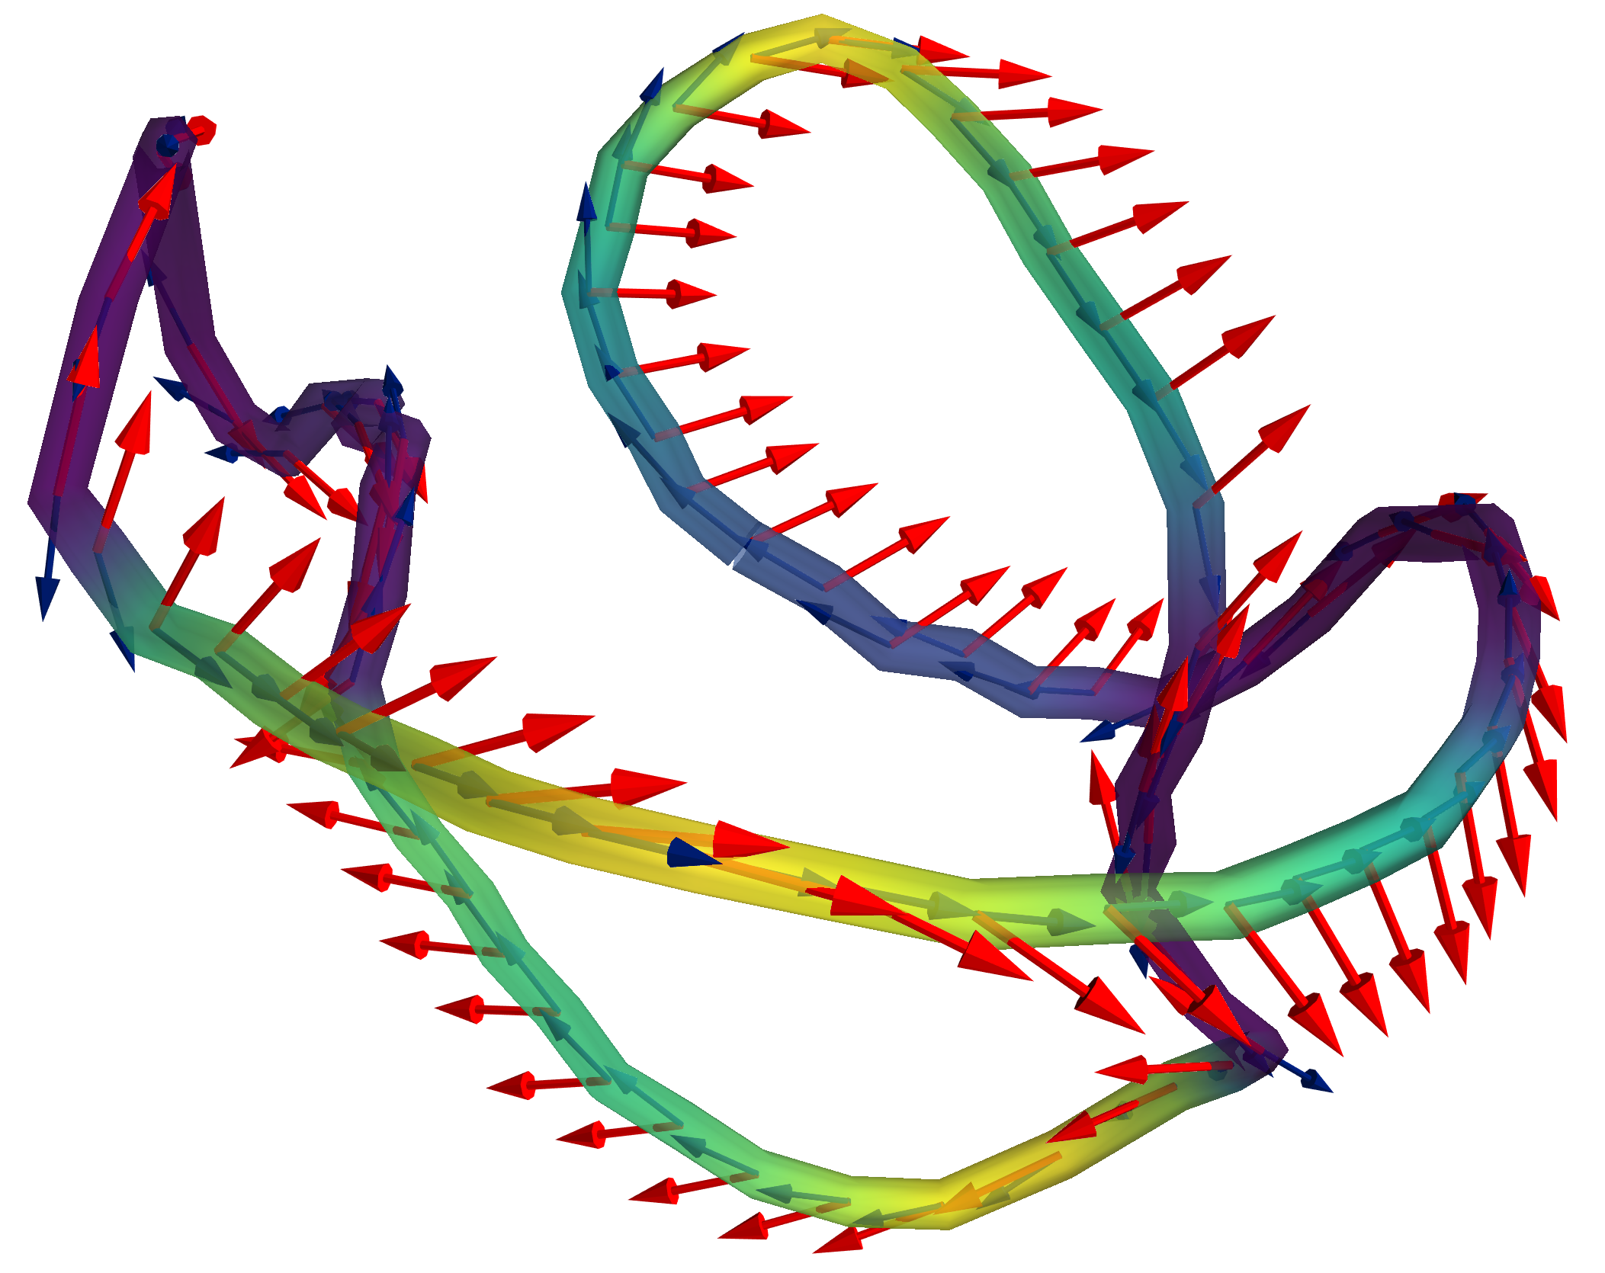
Outline of workshop
How Mayavi works
Getting started
Work through examples
Might be time to play around

Slide 4
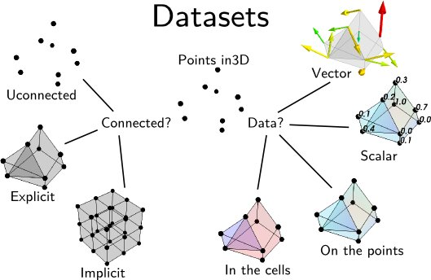
Features of Mayavi
Written in Python
Uses VTK library
Handles datasets mostly automatically
Operates using pipelines

Slide 5
Mayavi pipeline
Scene
Data sources
Filters
Modules
Where everything happens
VTK objects/ TVTK
Operate on data
Visualise data

Slide 6
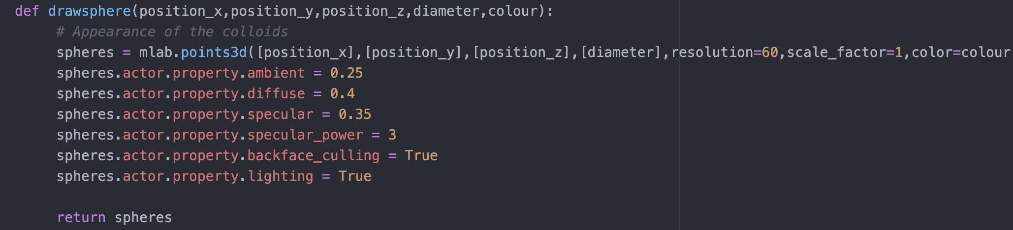
Interacting with the pipeline
Interactive pipeline
Hardcode in python

Slide 7
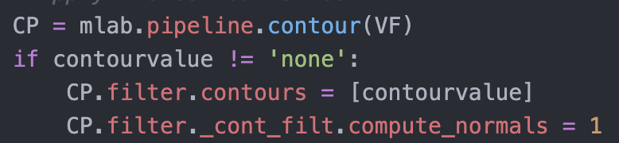
Learning about Mayavi objects + filters
Use the interactive pipeline
Search website
https://docs.enthought.com/mayavi/mayavi/auto/examples.html
Print python structures
Using pretty print:
Terminal: pip install pprint
Python: from pprint import pprint
pprint(vars(CP.filter))
Mayavi inbuilt:
Python: print_traits(CP.filter)

Slide 8
Getting started
Python packages
Examples from github
pip install mayavi
git clone https://github.com/LCHead/mayavi.git
https://github.com/LCHead/mayavi
https://docs.enthought.com/mayavi/mayavi/installation.html

Slide 9
Examples
Polymer in a box
Nematic defect
Active nematic channels

Slide 10
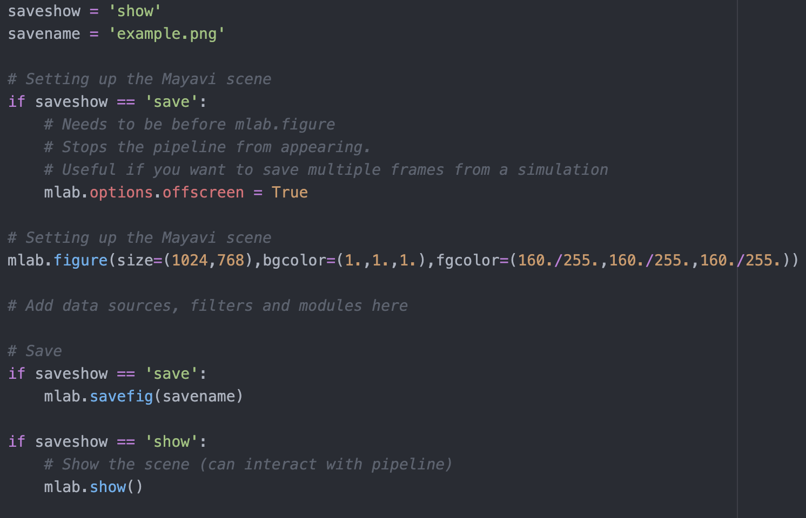
A basic script for making and saving scene

Slide 11
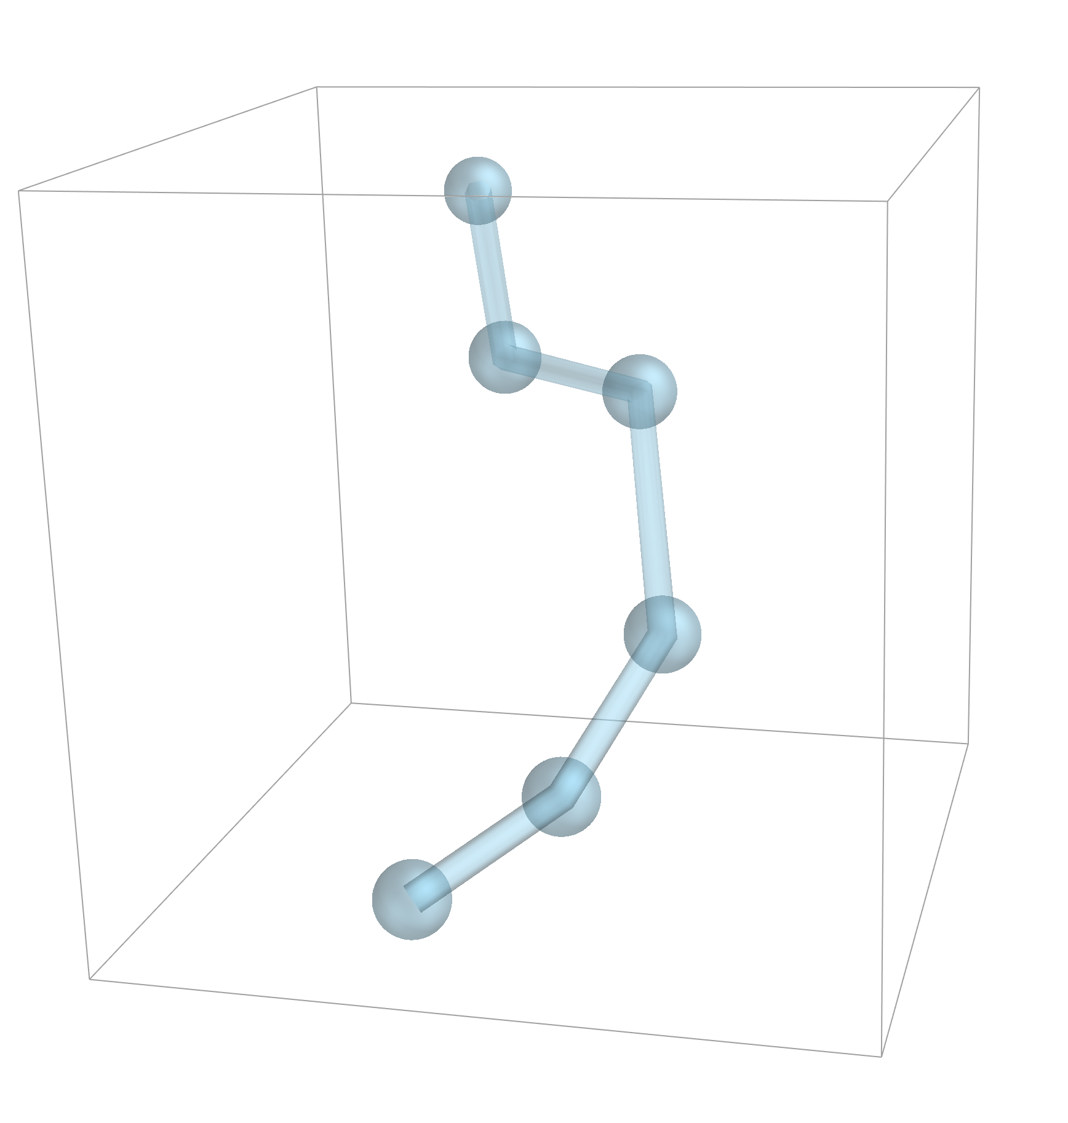
Example 1: Polymer in a box
Set up monomer points
Beads at monomer positions
mlab.points3d(xpoints, ypoints, zpoints, diameter)
Bonds between monomers
mlab.plot3d(xpoints, ypoints, zpoints, tube_radius)
Box
mlab.outline(extent=[0,xyz[0],0,xyz[1],0,xyz[2]],line_width=2)

Slide 12
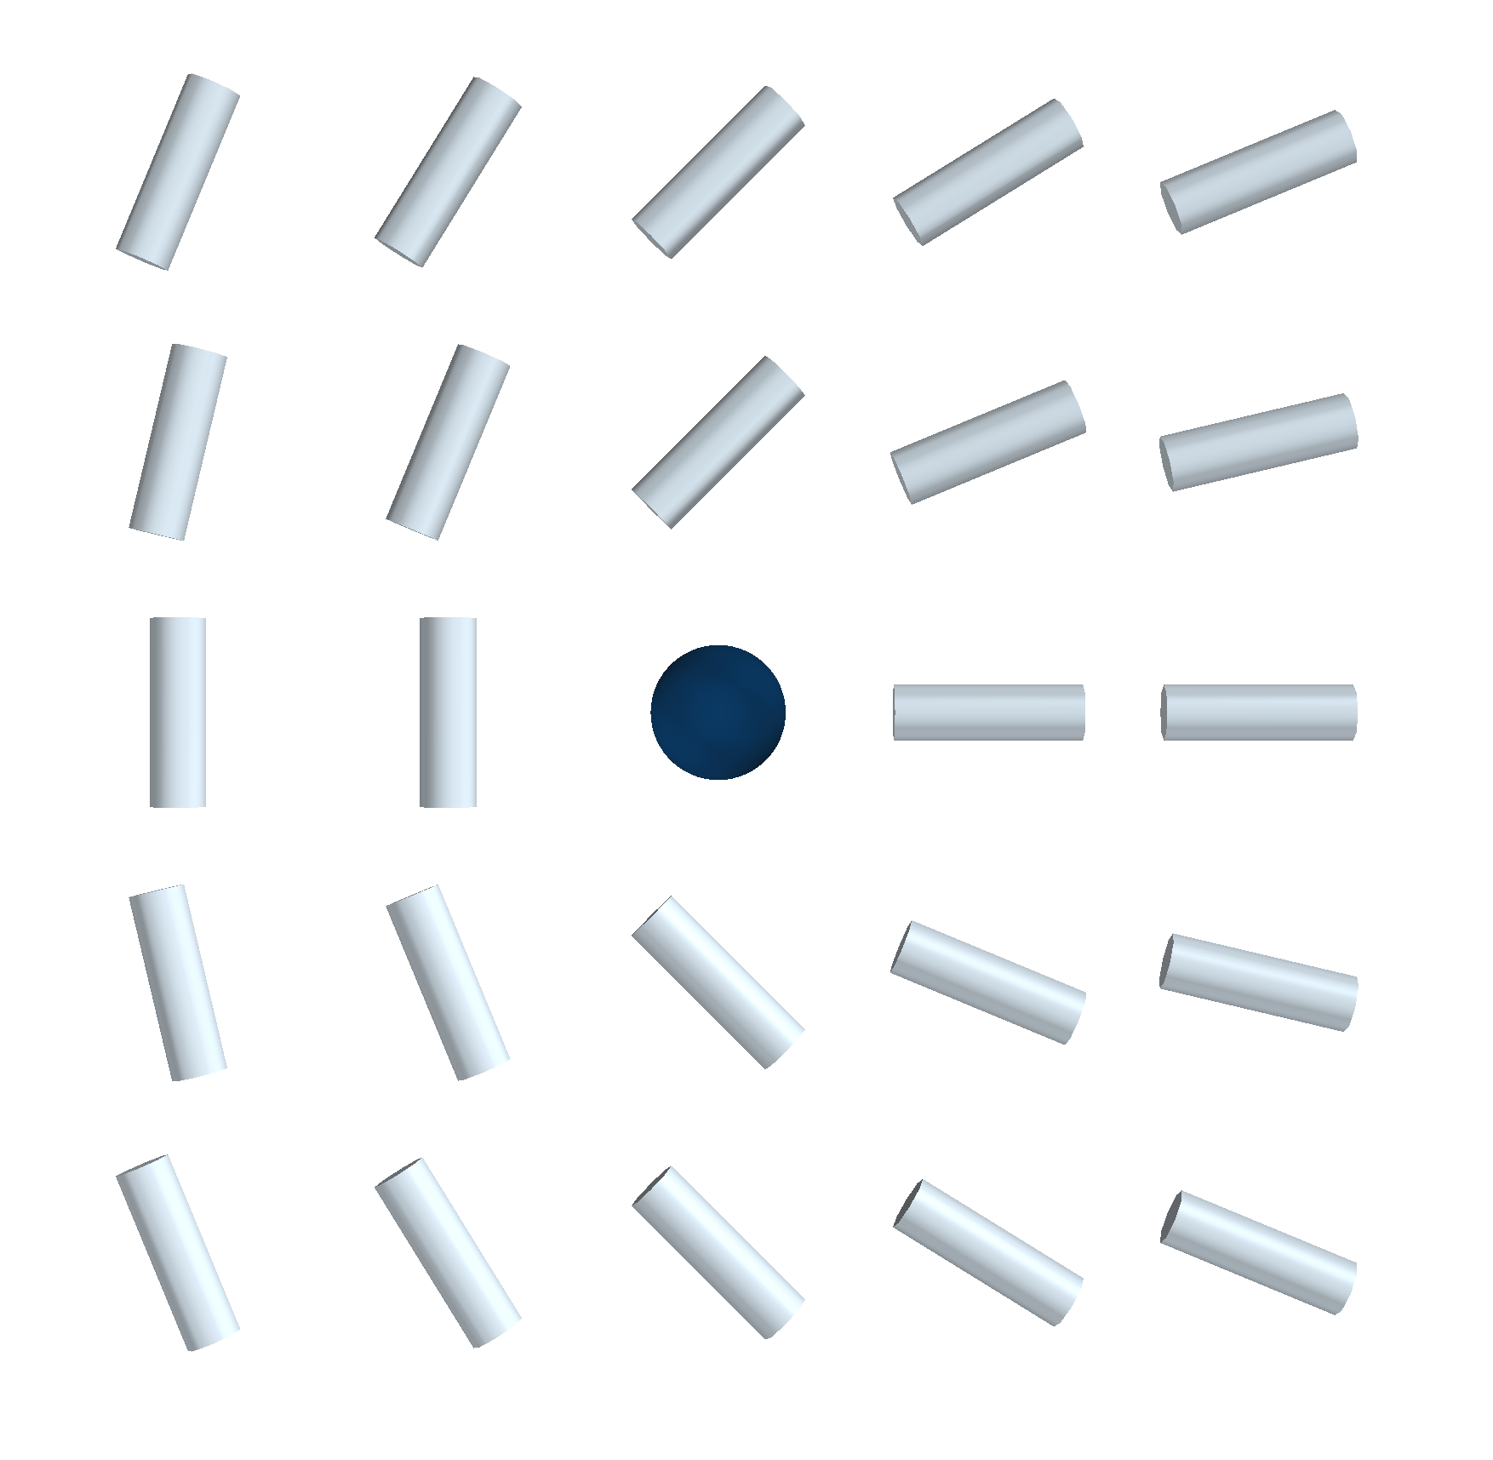
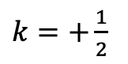

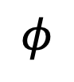
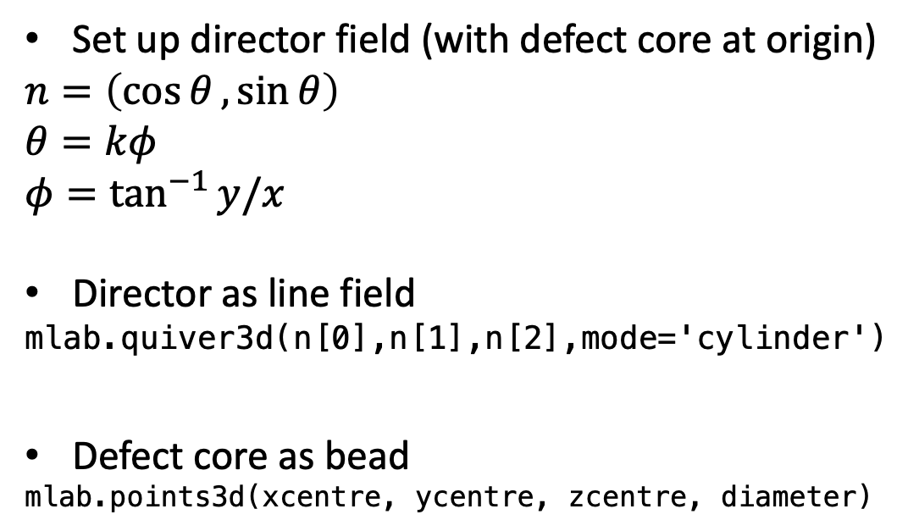
Example 2: Defect
$$θ$$
Set up director field (with defect core at origin)
$n=\left(\cos{θ},\sin{θ}\right)$
$$θ=kφ$$
$φ=\tan^{−1}{y/x}$
Director as line field
mlab.quiver3d(n[0],n[1],n[2],mode='cylinder')
Defect core as bead
mlab.points3d(xcentre, ycentre, zcentre, diameter)
$$φ$$
$k=+\frac{1}{2}$

Slide 13
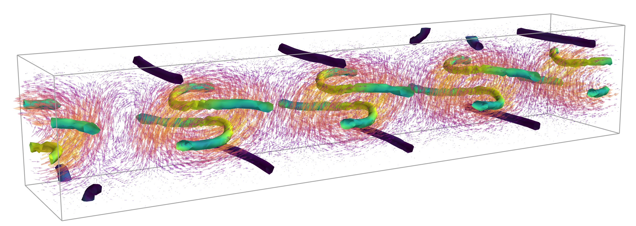
Example 3: Vortex lattice
Active nematic in a channel

Slide 14
Example 3: Vortex lattice
Visualising the velocity field
VF = mlab.quiver3d(vel[0],vel[1],vel[2])
Or
VF = mlab.pipeline.vector_field(vel[0],vel[1],vel[2], mode='arrow’)
VF = mlab.pipeline.glyph(VF, mode='arrow’)

Slide 15
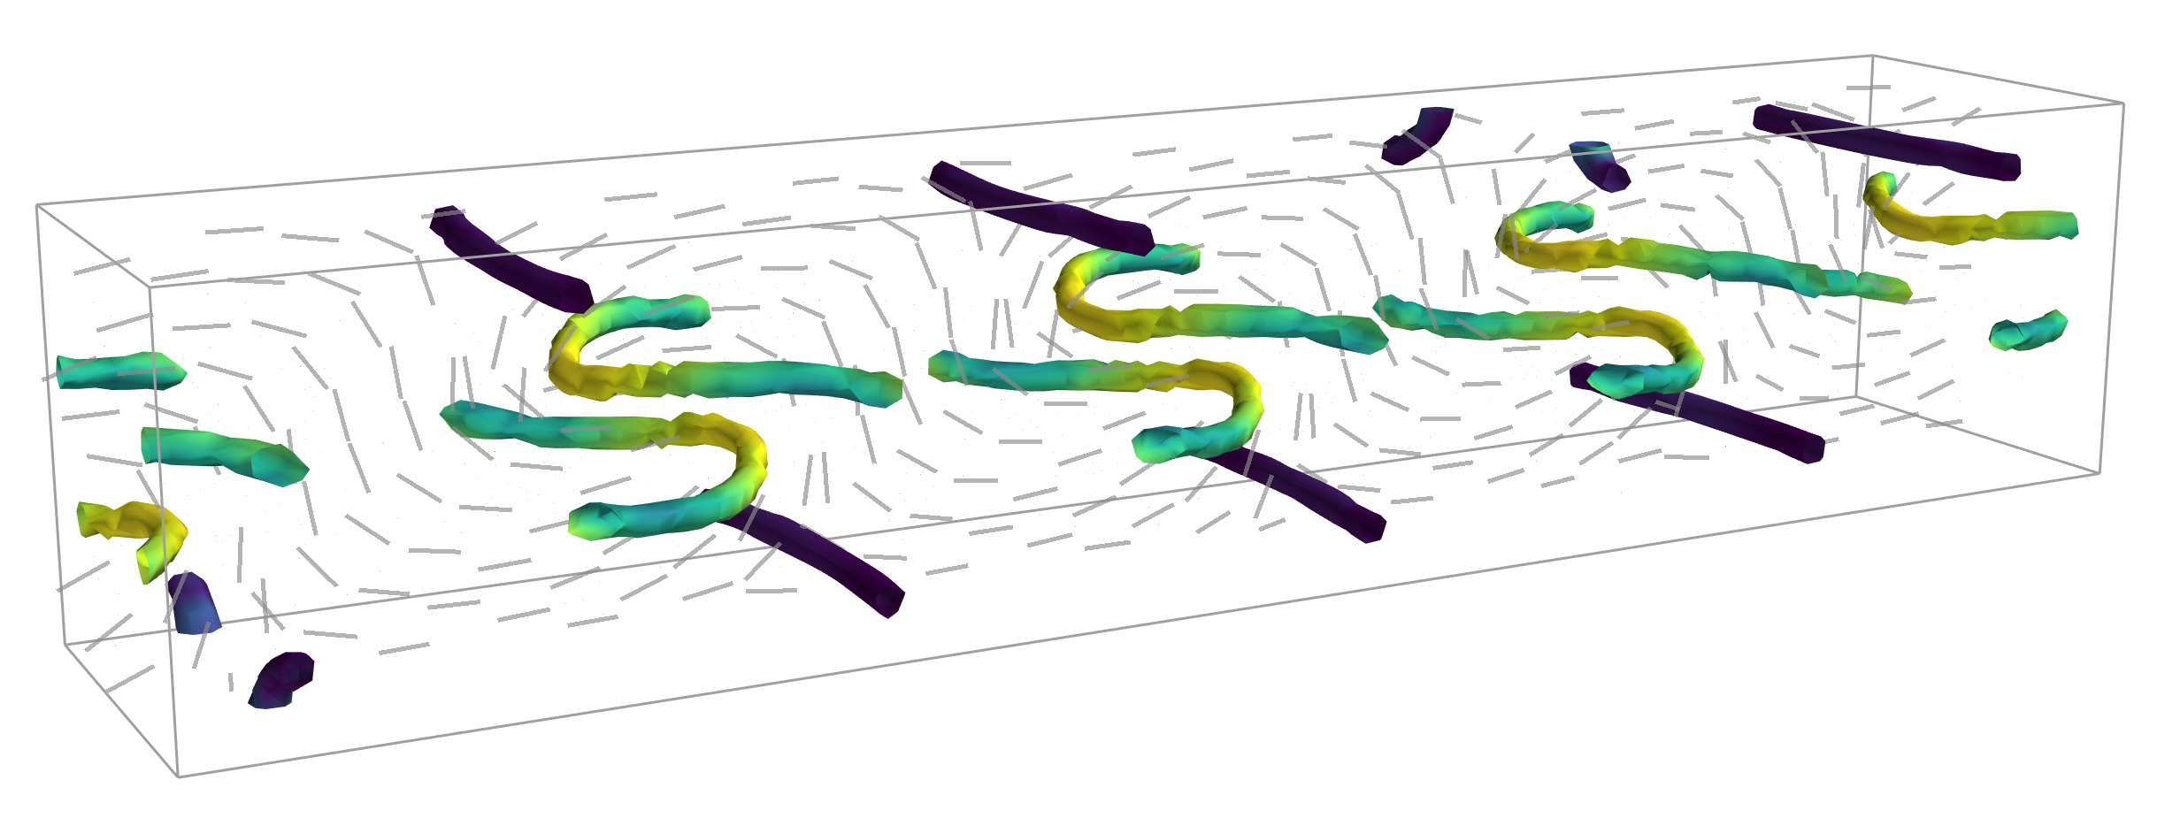
Example 3: Vortex lattice
Visualising the director field on a slice
DF = mlab.pipeline.vector_field(dir[0],dir[1],dir[2]) # load data source
DF = mlab.pipeline.vector_cut_plane(DF,mode='2ddash’) # vector cut plane module
DF.implicit_plane.widget.normal = [0,1,0] # orientation of slice
DF.implicit_plane.widget.origin = [0,12.5,0] # position of slice

Slide 16
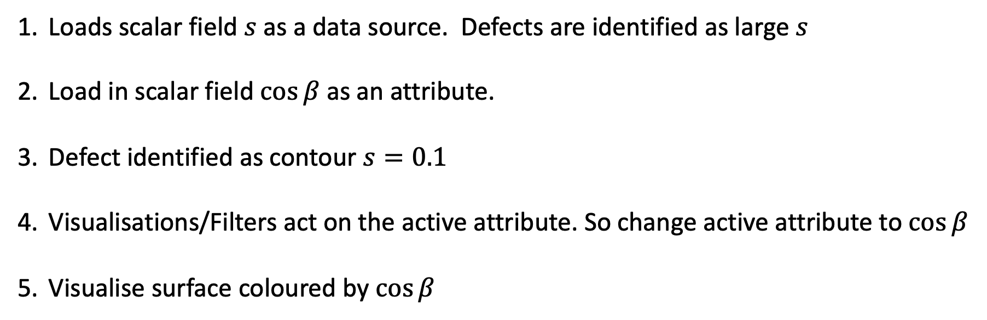
Example 3: Vortex lattice
Visualising the defect
Utilises attributes
Loads scalar field $s$ as a data source. Defects are identified as large $s$
Load in scalar field $\cos{β}$ as an attribute.
Defect identified as contour $s=0.1$
Visualisations/Filters act on the active attribute. So change active attribute to $\cos{β}$
Visualise surface coloured by $\cos{β}$

